Slide 1
EDP 2024 REVIEW
Demographics & Economic Markers for Polk County and Bolivar, MO

Slide 2
EDP Mission
PROMOTE | Economic Growth
CREATE | Job Opportunities
ENCOURAGE | Workforce Development
IMPROVE | Economic Well-Being and Wealth Creation
30 June 2022
New Board of Directors Established June 30, 2022
5 Jan. 2023
Received Non-Profit Status as a 501(c) (3) on Jan. 5, 2023
June 2024
Hired new president/CEO June 2024

Slide 3
EDP Board of Directors
Nick Seiner, Southwest Electric Coop, Chairman
Shannon Hancock, Polk County Presiding Commissioner, Vice Chairman
Leon Wirth, Southwest Baptist University, Secretary
Tracy Slagle, Liberty Utilities, Treasurer
Michael Calhoun, Citizens Memorial Hospital/Healthcare Foundation
Pat Douglas, Industrial Development Authority
Paul Folbre, Bolivar Area Chamber of Commerce
Michael Methvin, Bolivar R-1 Schools
Kelly Parson, OakStar Bank
Thomas Relford, City of Bolivar
Stephen Skopec, Tracker/White River Marine
Mike Stephens, Newly elected Mayor, City of Bolivar
Micah Titterington, Community Outreach Ministries

Slide 4
Long-term Priorities
Five Key Growth Initiatives
Professional housing: Increased housing options for professionals
Resources
Local Developers
CMH / SBU
Sports & Entertainment Project: Improve Fullerton Fields and other Sports Facilities to Host Tournaments
Promote Tourism
Resources
Local Developers / SBU
State / Federal grants
Community Business Funding
OTC / Technical School Option
Resources / Updates
Investigate Local and Possible State Funding
Education Grants
Pursue a trade school
New Growth/Kids Win Missouri Childcare Initiative
Assistance and planning to develop a plan of action addressing childcare and early education gaps
Ongoing Development Initiatives / Updates
Retail
Potential Manufacturing opportunities for the Business Park
General Housing Improvement Plan
Broadband Initiative
Did not get approved

Slide 5
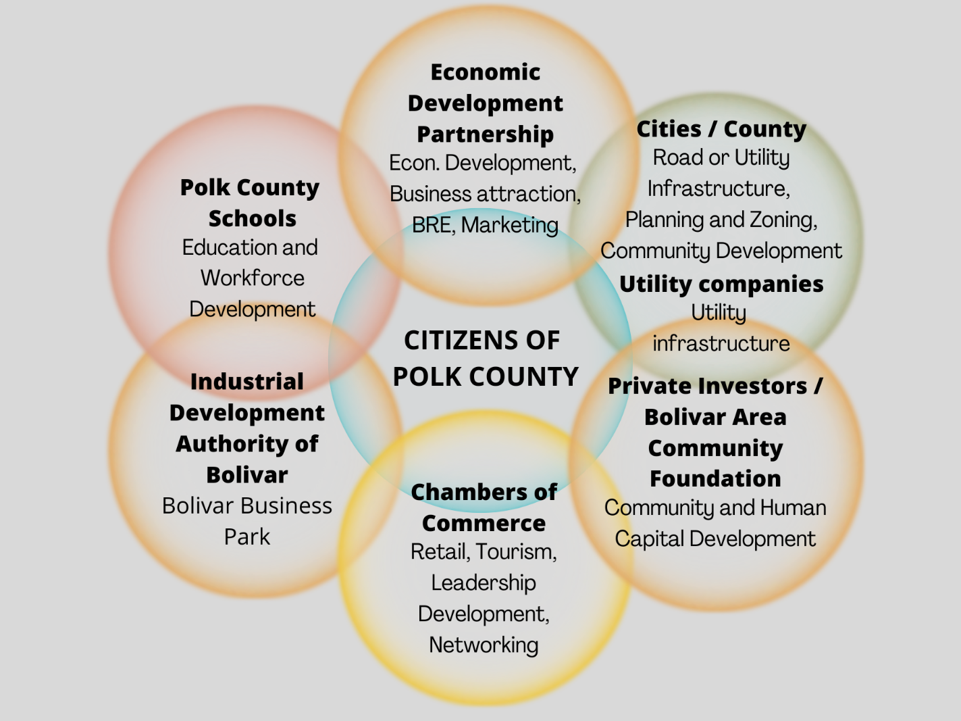
What does Economic Development look like in Bolivar and Polk County?
An EDO works closely with each of these entities, throughout projects and over time, i.e., when Tracker needs recruiting assistance; an entrepreneur wants to open a new business; or a small business is looking to expand or move into a new building.

Slide 6
City of Bolivar
Demographics & Housing
POPULATION – 11,338
Under 18 21.4% Male 45.6%
Ages 18-64 59.7% Female 54.4%
65 & Over 19.4%
EDUCATIONAL ATTAINMENT
Population 25 years & up – 6,509
Bachelor’s Degree or higher – 25.5%
Some college, no degree – 19.8%
High School or equivalent – 88.9%
Source: U.S. Census Bureau, Quick Facts, ACS 5-year estimates (V2023).
Source: U.S. Census Bureau, American Community Survey, 2015-2019. Population 25 years & over.
HOUSEHOLDS & INCOME
No. of Households – 4,219
Median Household Income – $38,396
Per Capita Income – $ 24,273
POVERTY INDICATORS
Poverty Rate – 21.1%
Children under 18 in poverty – 24%
Ages 18 to 64 in poverty – 23.2%
Seniors (65 and over) in poverty – 12.1%
Civilian non-institutionalized population – 10,732;
Ages 18 and younger: 2,604; with no insurance – 9.2%
Ages 19 to 64: 6,131; with no insurance – 20.4%
Source: U.S. Census Bureau, 2020 (Population estimate).
HOUSING & OCCUPANCY
Total Housing Units – 4,743
Occupied housing units – 4219
54.4% Home Ownership Rate
Renter-occupied – 1,925
Vacant Housing Units – 524 (11%)
Rental Vacancy Rate – 6.5%
HOME VALUES
Median Home Value – $188,700 (of owner-occupied units)
Average Home Value – $245,235
Sources: U.S. Census Bureau, ACS 2019-2023 5-year estimates, unless otherwise stated.
Notes:
USE MISSOURI CENSUS DATA CENTER TO GET ACS PROFILE REPORT FOR 2019-2023;
Sub categories of DEMOGRAPHIC, SOCIAL, ECONOMIC, HOUSING
CAN DO THIS FOR PLACES (cities) and COUNTIES.

Slide 7
Polk County Demographics
POPULATION – 32,780
Under 5 6.3%
Under 18 23.2%
18 to 64 58.1%
65 & over 18.7%
Projected 2030: 40,139
Male 16,258
Female 16,521
Veterans 4.7% (residents, ages 18-64)
Source: U.S. Census Bureau, ACS 5-year estimates (V2023) (as of 7/1/2024); Missouri Census Data Center; ACS 2018-2022 for veterans.
POVERTY INDICATORS
Poverty Rate – 17.9% (total)
Children under 18 in poverty – 22.6%
Ages 18 to 64 in poverty – 17.4%
Seniors (65 and over) in poverty – 13.2%
Civilian noninstitutionalized population – 31,661 (1,456 live in group quarters)
Ages 18 and below: 8,006; those without insurance – 14.9%
Ages 19 to 64: 18,068; those without insurance – 16.4%
EDUCATIONAL ATTAINMENT
Population 25 years & up – 21,052
Bachelor’s Degree or higher – 21.0%
Some College, no degree – 23.4%
High School or equivalent – 88.8%
Source: U.S. Census Bureau, ACS 2019-2023 5-year estimates (unless otherwise stated).
Source: Missouri Census Data Center, Missouri County Fact Sheet for Polk County (2025) (Population by select age cohorts (as of July 1, 2024)).
Value of Owner-Occupied Homes in Polk County, by percentage
HOUSING & OCCUPANCY
Total Housing Units – 13,434
Occupied Housing Units – 11,957
Owner-occupied – 71.3% (8,523)
Renter-occupied – 28.7% (3,434)
Median Home Value – $189,600
Average Home Value – $244,583
Vacant Housing Units – 10.4%
Homeowner vacancy rate – 0.8
Renter vacancy rate 4.3
No. of Bedrooms in Occupied
Housing Units
1 – 6.3%;
2 or 3 – 74.3%;
4 or more – 18.4%
HOUSEHOLDS
No. of Households
11,957
Median Household Income
$56,686
Per Capita Income
$28,199
Sources: U.S. Census Bureau, American Community Survey, 2019-2023 (unless otherwise stated).

Slide 8
Economic Indicators
Annual Household Income
Source: U.S. Census Bureau, American Community Survey, 5-year estimates.

Slide 9
Polk County Households
Income range per household, as a percentage
Quick Facts
Polk County
County population: 32,780
# of Households: 11,957
Median household income: $56,686
Per capita income in past 12 months: $28,199
Persons in poverty: 14.6%
In civilian labor force, total, 16 years+: 55.6%
Persons with no health insurance, <65: 13.1%
Bolivar
City population: 11,338 (pop. Est. July 1, 2023, (V2023))
# of Households: 4,219
Median household income: $44,603
Per capita income in past 12 months: $24,723
Persons in poverty: 21.1%
In civilian labor force, total, 16 years+: 51.9%
Person with no health insurance, age< 65: 15.6%

Slide 10
Polk County Employment
Workforce Employment & Wages
Labor Force – 15,216 No. of Establishments, public and private – 7,390
Employment – 14,725 Annual Average Employment – 9,763 (2023) Sept. 2024 (P) 9,419
Unemployment – 491 Annual Average Weekly Wage – $878
Unemployment Rate – 3.2%, unadjusted Annual Wages per Employee – $45,655
Participation Rate of Labor Force – 55.6%
Source: Dec. 2024, Missouri Economic Research and Information Center (MERIC) with U.S. Dept. of Labor, Bureau of Labor Statistics; Quarterly Census of Employment & Wages – Bureau of Labor Statistics (2023 annual average); Census Bureau, 2019-2023 5-year estimates.
Average weekly wages
Over the last 14 years (2010-2023), Polk County saw weekly wages increase by 37.1%.
Information about Businesses in Polk County
Total employer establishments – 608 Total employment – 8,229
Total annual payroll, ($1,000) – $415,561 Non-employer establishments – 2,679
Who do Polk County Workers work for?
61.3% Private companies 13.1% Not-for-profit organizations
11.8% Local, state, and federal government 10.7% Self-employed, unincorporated
3.1% Self-employed in own incorporated business
Source: 2022 Economic Census
Source: U.S. Census Bureau, American Community Survey, 2015-2019, unless otherwise noted.

Slide 11
Establishments & Types of Jobs
No. of businesses over time
Sources: Quarterly Census of Employment & Wages, All Industries, Private & Public, All establishment sizes

Slide 12
Polk County: Payroll Wages Paid
Polk County saw nearly a 51% increase in payroll wages since 2010.
Source: Quarterly Census of Employment & Wages, All Industries, Private & Public, All establishment sizes

Slide 13
Polk County’s Gross Domestic Product
Source: U.S. Bureau of Economic Analysis, “CAINC30 Economic profile”
SELECTED SALES & REVENUE TOTALS IN POLK COUNTY
(Summary Statistics for the U.S. States and Selected Geographies, 2022)
$311.5 million Total Retail Sales; total retail sales per capita – $9,804
$297 million Total Professional, Scientific and Technical Services Sales / Revenues
$238.6 million Total Health Care and Social Assistance Receipts / Revenues
$28 million Total Accommodation and Food Services Sales
$9.85 million Total Transportation and Warehousing Receipts / Revenues
Source: U.S. Census Bureau, County Business Patterns, 2022.

Slide 14
What is a formal Economic Development Program?
Confidential Liaison for Prospective Businesses, Developers, etc.
Business Retention Efforts for Local Businesses
Facilitation of Federal and State Programs, Knowledge of Funding Mechanisms for Businesses
Advocate to Local Governments for Businesses and Developers
Community Liaison between Regional Organizations
Tracking of Economic Development Drivers, Markers

Slide 15
EDP would not be possible without our generous supporters. THANK YOU!
Investors include:
City of Bolivar
Polk County
Southwest Electric Coop
Citizens Memorial Hospital
Citizens Memorial Healthcare Foundation
Liberty Utilities
The Industrial Development Authority of Bolivar, MO
Southwest Baptist University
Ollis/Akers/Arney (Paul Long)
OakStar Bank
Best Western Plus
Bolivar Area Chamber of Commerce
White River / Tracker Marine
Bill Roberts Chevrolet
And other supporters: Bank of Missouri, Comfort Inn, Commerce Bank, Flora Farms, JMARK, LimeBank, Mid-Missouri Bank, US Bank, Warwick Electric, Woods Supermarket.
Follow EDP on Facebook at https://www.facebook.com/bolivarmoeconomicdevelopmentpartnership/
Our website has moved to www.bolivarmoedp.com and is being updated.

